Slide 1
Cyberpatriot Session VI
Internet Operating System (IOS) Fundamentals

Slide 2
Agenda
IOS
Cisco Networking Devices
Interfaces
Switching 101
VLANs
Routing 101
Basic IOS Commands

Slide 3
Agenda
IOS

Slide 4
IOS – The “Brains Behind The Magic”
Cisco IOS® Software is the world's leading network infrastructure software, delivering a seamless integration of technology innovation, business-critical services, and hardware platform support. Currently operating on millions of active systems, ranging from the small home office router to the core systems of the world's largest service provider networks, Cisco IOS Software is the most widely leveraged network infrastructure software in the world.
Cisco IOS (originally Internetwork Operating System) is software used on Cisco Systems routers and current Cisco network switches. IOS is a software package of routing, switching, internetworking and telecommunications functions integrated into a multitasking operating system.

Slide 5
Agenda
Cisco Networking Devices

Slide 6
Cisco Networking Devices (Icons)
Laptop – PC, Mac
Desktop – PC, iMac
Smart Device – iPad, iPhone, Galaxy, Etc
Server – Education Application, Facebook,

Slide 7
Cisco Networking Devices (Icons)
Network Switch – Street with Mailboxes
Wireless Access Point – Same as a switch, just no wires!
Network Router = Post Office

Slide 8
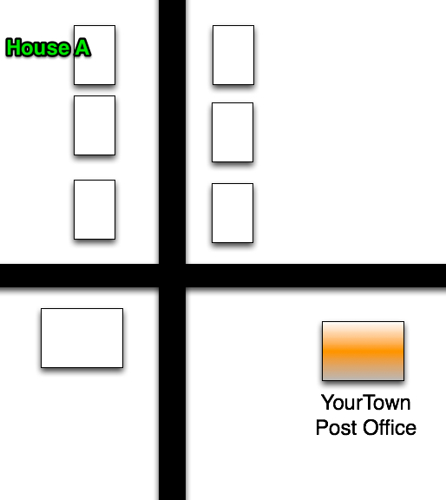
Two towns

Slide 9
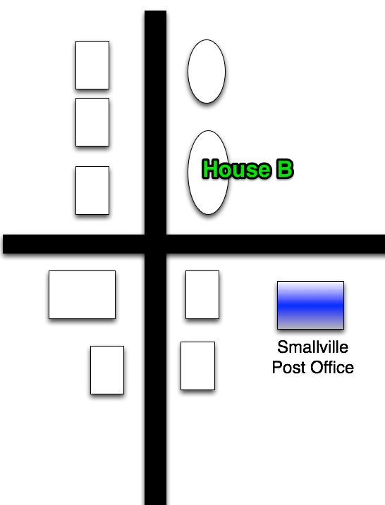
Two towns

Slide 10
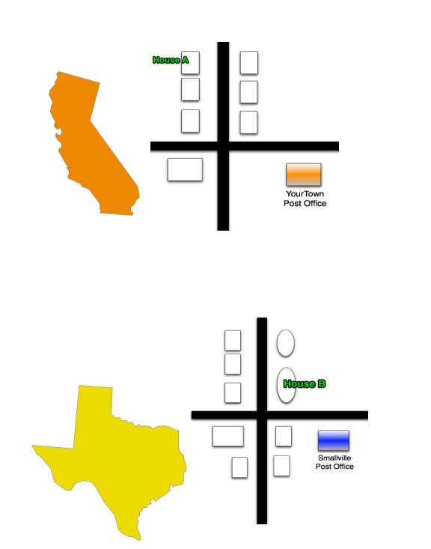

Slide 11
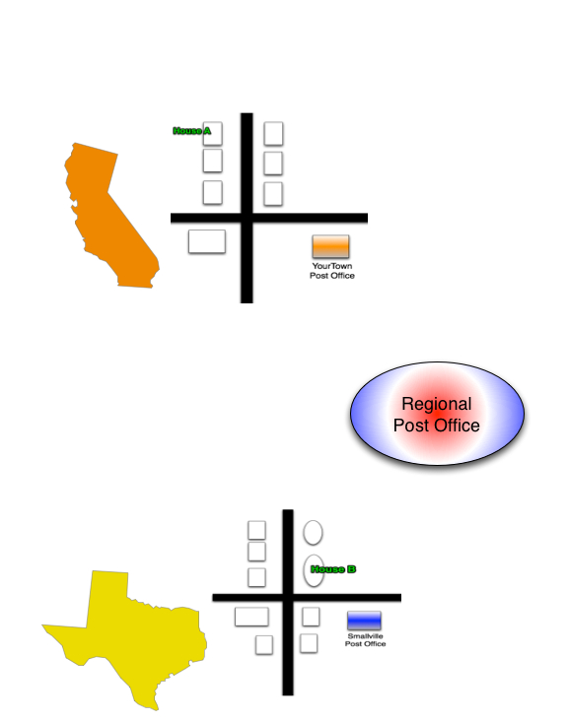

Slide 12
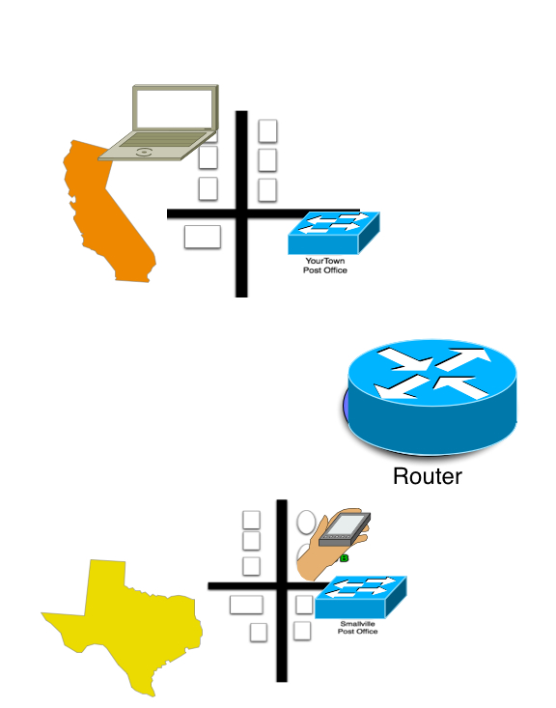

Slide 13
Agenda
Interfaces

Slide 14

Interface Defined
A hardware interface is described by the mechanical, electrical and logical signals at the interface and the protocol for sequencing them (sometimes called signaling).
Think Lock and Key

Slide 15
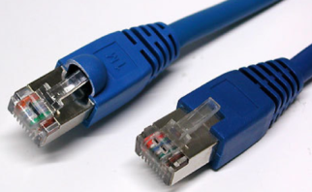
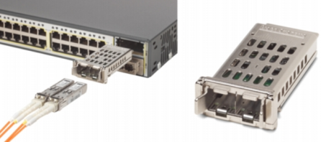
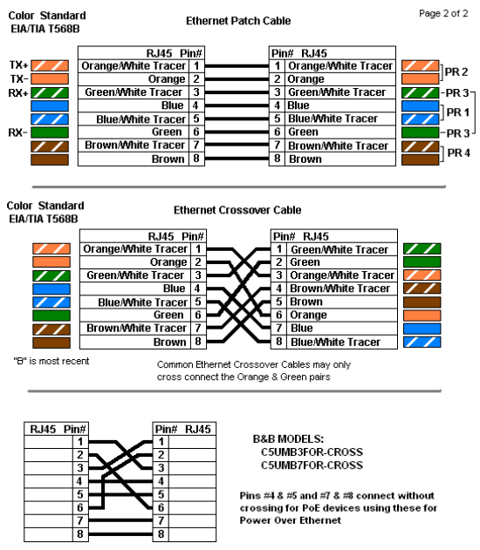
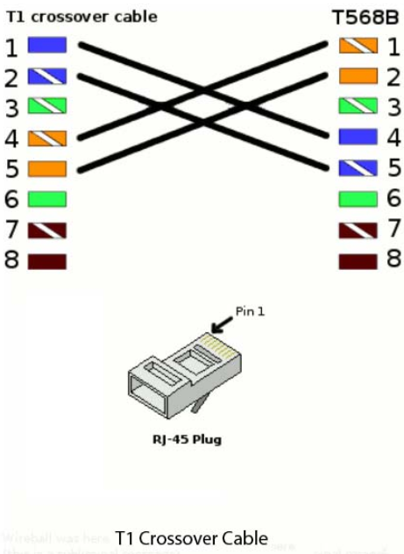
Interface Examples
RJ-45
Optical
Serial

Slide 16
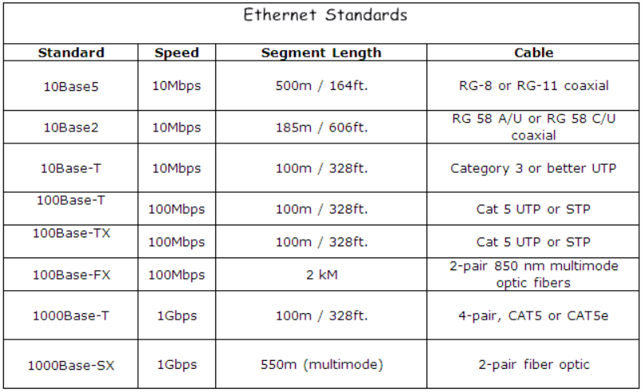
Interfaces – Speeds and Feeds

Slide 17
Agenda
Switching 101

Slide 18
Switching 101
Layer 2 switching uses the media access control address (MAC address) from the host's network interface cards (NICs) to decide where to forward frames. Layer 2 switching is hardware based, which means switches use special chips called application-specific integrated circuit (ASICs) to build and maintain filter tables (also known as MAC address tables or Content Addressable Memory or CAM tables).
Network Switch – Neighborhood with Streets and Mailboxes

Slide 19

Switching 101
Mac
PC
Blackberry
Printer
Galaxy
Switch
Access
Point
IP Phone
iPad
Router
iPhone
Server Farm

Slide 20
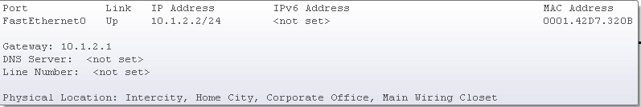
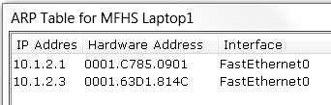
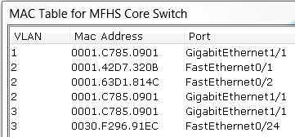
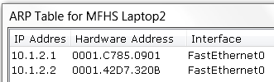
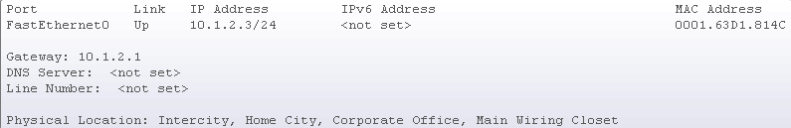
Switching 101
Network Switch – Neighborhood with
Streets and Mailboxes
MFHS Laptop1
MFHS Laptop2

Slide 21
Agenda
VLANs

Slide 22
Virtual Local Area Network (VLAN)
A single layer-2 network which is partitioned to create multiple distinct broadcast domains, which are mutually isolated so that packets can only pass between them via one or more routers; such a domain is referred to as a virtual local area network, virtual LAN or VLAN

Slide 23
Virtual Local Area Network
VLAN 1
LAN
VLAN 2

Slide 24
Agenda
Routing 101

Slide 25
Routing 101
A router is a device that forwards data packets between computer networks. It is connected to two or more data lines from different networks and when a data packet comes in one of the lines, the router reads the address information in the packet to determine its ultimate destination. Then, using information in its routing table, it directs the packet to the next network on its journey. Routers perform the "traffic directing" functions on the Internet.
Network Router – Connect the Neighborhoods

Slide 26
Routing 101
Network Router – Connect the Neighborhoods
Starbucks
Mac
PC
Blackberry
Printer
Galaxy
Router
Switch
Access
Point
IP Phone
iPad
iPhone
Router
Server Farm
MFHS
HSH
Router
Router
Router
Mac
PC
Mac
PC
Blackberry
Blackberry
Printer
Printer
Galaxy
Galaxy
Switch
Access
Point
Switch
Access
Point
IP Phone
IP Phone
iPad
iPad
iPhone
iPhone
Server Farm
Server Farm

Slide 27
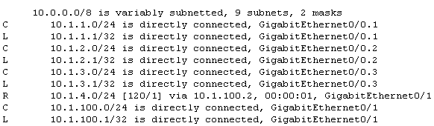
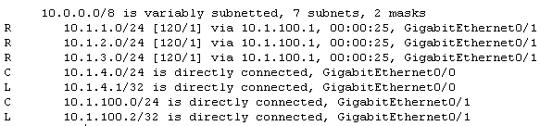
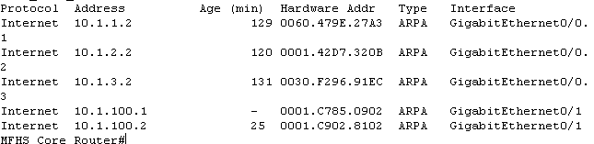

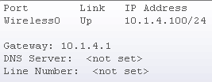

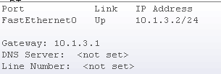

Routing 101
MFHS
HSH
G0/1
G0/1
G0/0.3
G0/0
Router
Router
Switch
Switch
Access Point
Server
iPad

Slide 28
Agenda
Basic IOS Commands
&
Configuration

Slide 29
Basic IOS Modes and Commands
User EXEC Mode
The default command mode for the CLI is user EXEC mode. The EXEC commands available at the user EXEC level are a subset of those available at the privileged EXEC level. In general, the user EXEC commands allow you to connect to remote devices, change terminal settings on a temporary basis, perform basic tests, and list system information. The prompt for user EXEC mode is the name of the device followed by an angle bracket: Router>.
Privileged EXEC Mode
Privileged EXEC mode is password protected, and allows the use of all EXEC mode commands available on the system. To enter privileged EXEC mode from user EXEC mode, use the enable command. Privileged EXEC mode allows access to global configuration mode through the use of the enable command. The privileged EXEC mode prompt consists of the devices's host name followed by the pound sign: Router# .
Global Configuration Mode
Global configuration commands generally apply to features that affect the system as a whole, rather than just one protocol or interface. You can also enter any of the specific configuration modes listed in the following section from global configuration mode.
To enter global configuration mode, use the configure terminal privileged EXEC command. The router prompt for global configuration mode is indicated by the term config in parenthesis: Router(config)#
? – View available commands
enable – Privileged EXEC Mode
configure terminal – Global Configuration Mode
enable password – Set privileged password
show – View information about specific things on router
exit – Back up one level
end – Exit back to global command line
write memory – Save your configurations
logout

Slide 30
Switch Configuration
enable Privileged EXEC Mode
configure terminal
enable password (ex. Cisco)
hostname (ex. MFHS_Switch) no spaces allowed in hostname
interface (ex. fastethernet 0/1)
description (ex. Connection MFHS Laptop1) any description you wish
ip address (ex. 10.1.2.2 255.255.255.0) ip address and subnet mask
switchport access vlan 2 (ex. Sets port to access only vlan 2) or…
switchport mode trunk (ex. Sets port to trunk all Vlans)
end
write memory (ALAWAYS, ALWAYS, ALWAYS SAVE YOUR WORK)

Slide 31
Router Configuration
enable Privileged EXEC Mode
configure terminal
hostname (ex. MFHS_Router) no spaces allowed in hostname
interface (ex. gigabit 0/0) and/or…
interface (ex. gigabit 0/0.2 when setting up Vlan Trunk)
description (ex. Connection HSH Router) any description you wish
ip address (10.1.100.1 255.255.255.0) ip address and subnet mask
encapsulation dot1q 2 (ex. Set when trunking vlan 2)
end
write memory (ALAWAYS, ALWAYS, ALWAYS SAVE YOUR WORK)

Slide 32
End-Point Configuration
Name Your Device (ex. HSH iPad)
IP Address (ex. 10.1.4.100)
Subnet Mask (ex. 255.255.255.0)
Default Gateway (ex. 10.1.4.1)

Slide 33
